Slide 1
PSCS_8 - "AI-powered Legal Documentation Assistant"
PIP4004 Capstone Project
Review-0
Batch Number: G45
Under the Supervision of,
Ms. Sreelatha PK
Assistant Professor
School of Computer Science and Engineering
Presidency University
Roll Number | Student Name
20211CSE0846 | VAISHNAVI C
20211CSE0298 | SHRUTHI V
20211CSE0308 | RUTHIKA S SHETTY
Name of the Program: CSE
Name of the HoD: Dr. Asif Mohammed H.B
Name of the Program Project Coordinator: Mr. Amarnath J.L & Dr. Jayanthi. K
Name of the School Project Coordinators: Dr. Abdul Khadar A

Slide 2
Content
Problem Statement
GitHub Link
Analysis of Problem Statement
Timeline of the Project
References

Slide 3
Problem Statement Number:
Organization: Presidency University
Category (Hardware / Software / Both) : Software
Problem Description: PSCS_8 - "AI-powered Legal Documentation Assistant"
Difficulty Level: Simple

Slide 4
GitHub Link
The GitHub link provided should have public access permission.
https://github.com/vaishnavi-c-2025/AI-powered-Legal-Documentation-Assistant

Slide 5
Analysis of Problem Statement
Technology Stack Components:
1. Programming Language: Python
2. AI & NLP:
spaCy (for text processing and legal terminology simplification)
NLTK (for additional text processing if needed)
OpenAI GPT or Llama (for AI-powered document generation)
3. Legal Text Processing:
pdfminer or PyMuPDF (for reading legal PDFs)
docx (for working with Word documents)
4. Data Handling:
pandas (for structuring legal datasets)

Slide 6
Analysis of Problem Statement (contd...)
Software Requirements:
Operating System: Windows/Linux/macOS
Python Version: Python 3.8+
IDE: VS Code / PyCharm / Jupyter Notebook
Legal Data Sources: Publicly available legal documents (Indian Contract Act, templates, etc.)

Slide 7
Analysis of Problem Statement (contd...)
1. Problem Breakdown
Legal documentation is complex due to technical jargon.
Small businesses and individuals lack access to legal expertise.
Manual legal documentation is time-consuming and prone to errors.
2. Proposed AI-Powered Solution
Automates document generation using AI.
Simplifies legal jargon into plain language.
Customizes contracts based on user input.
Ensures accuracy by integrating legal databases.
Provides an option to consult experts for complex issues.

Slide 8
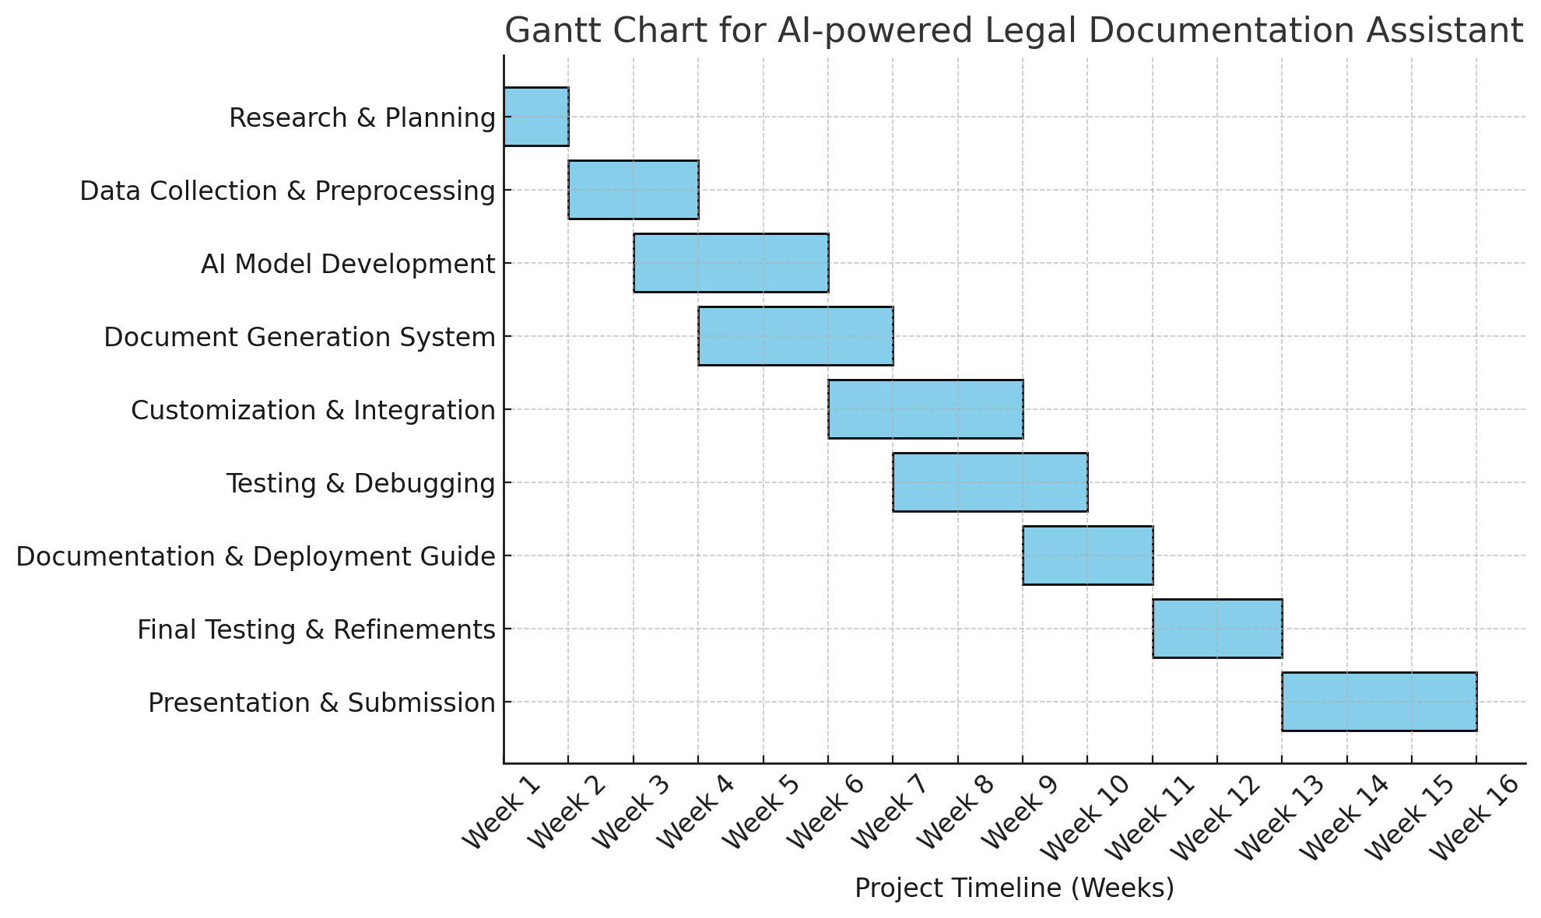
Timeline of the Project (Gantt Chart)

Slide 9
References (IEEE Paper format)
Imogen, Vimala & Sreenidhi, J. & Nivedha, V.. (2024). AI-Powered Legal Documentation Assistant. Journal of Artificial Intelligence and Capsule Networks. 6. 210-226. 10.36548/jaicn.2024.2.007.
"AI-Powered Legal Documentation Assistant", International Journal of Emerging Technologies and Innovative Research (www.jetir.org), ISSN:2349-5162, Vol.11, Issue 4, page no.k526-k530, April-2024.
Vayadande, Kuldeep & Bhat, Aditi & Bachhav, Pranav & Bhoyar, Aditya & Charoliya, Zulfikar & Chavan, Aayush. (2024). AI-Powered Legal Documentation Assistant. 84-91. 10.1109/ICPCSN62568.2024.00022.
Kiran Kumar, G. (2024). AI-powered Legal Documentation Assistant. International Journal of Engineering Innovations and Management Strategies 1 (1):1-13.
Imogen, P. Vimala, J. Sreenidhi, and V. Nivedha. "AI-Powered Legal Documentation Assistant." Journal of Artificial Intelligence and Capsule Networks 6, no. 2 (2024): 210-226

Slide 10


